Slide 1
Tree Shaped Indexes
Carsten Schürmann

Slide 2
Database System Architecture
Data Manipulation Language
(DML)
Data Definition Language
(DDL)
Query processing
Query evaluator
DML procedures
Query optimizer
Meta data
Storage manager
Transaction Manager
Buffering Manager
File Manager
Physical Level

Slide 3
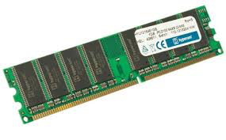
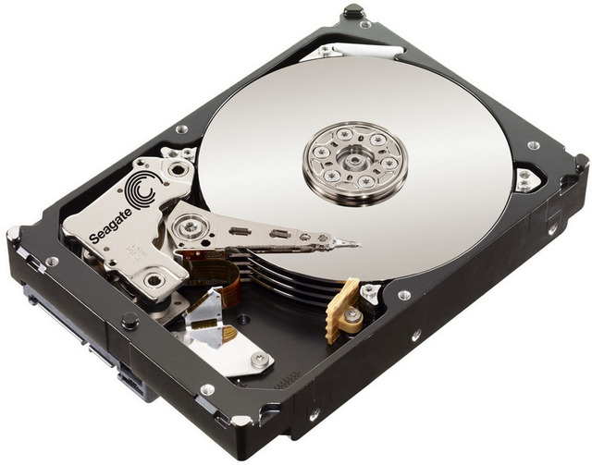
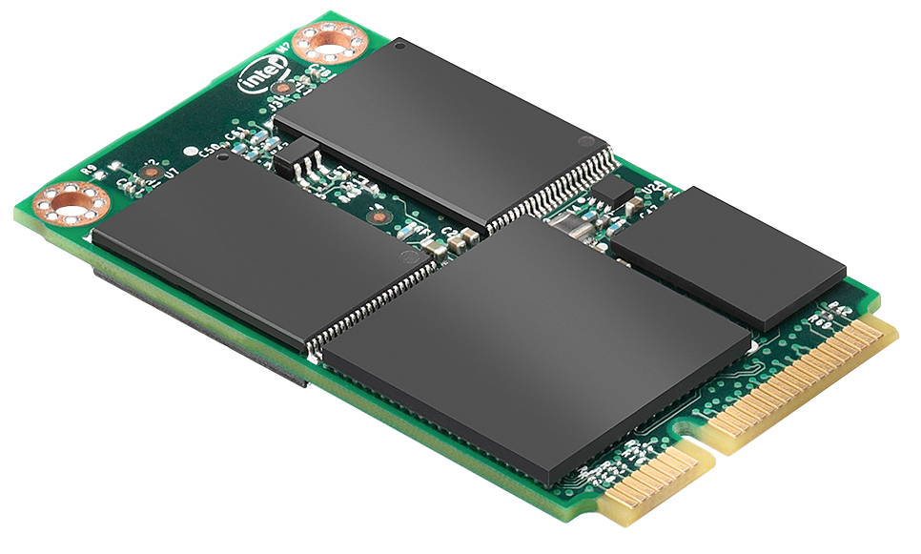
Physical Level
Ephemeral Storage
RAM
Registers on a CPU
Persistent Storage
Magnetism
Disk drives
Hard drives
Trapped electrons
SSD

Slide 4
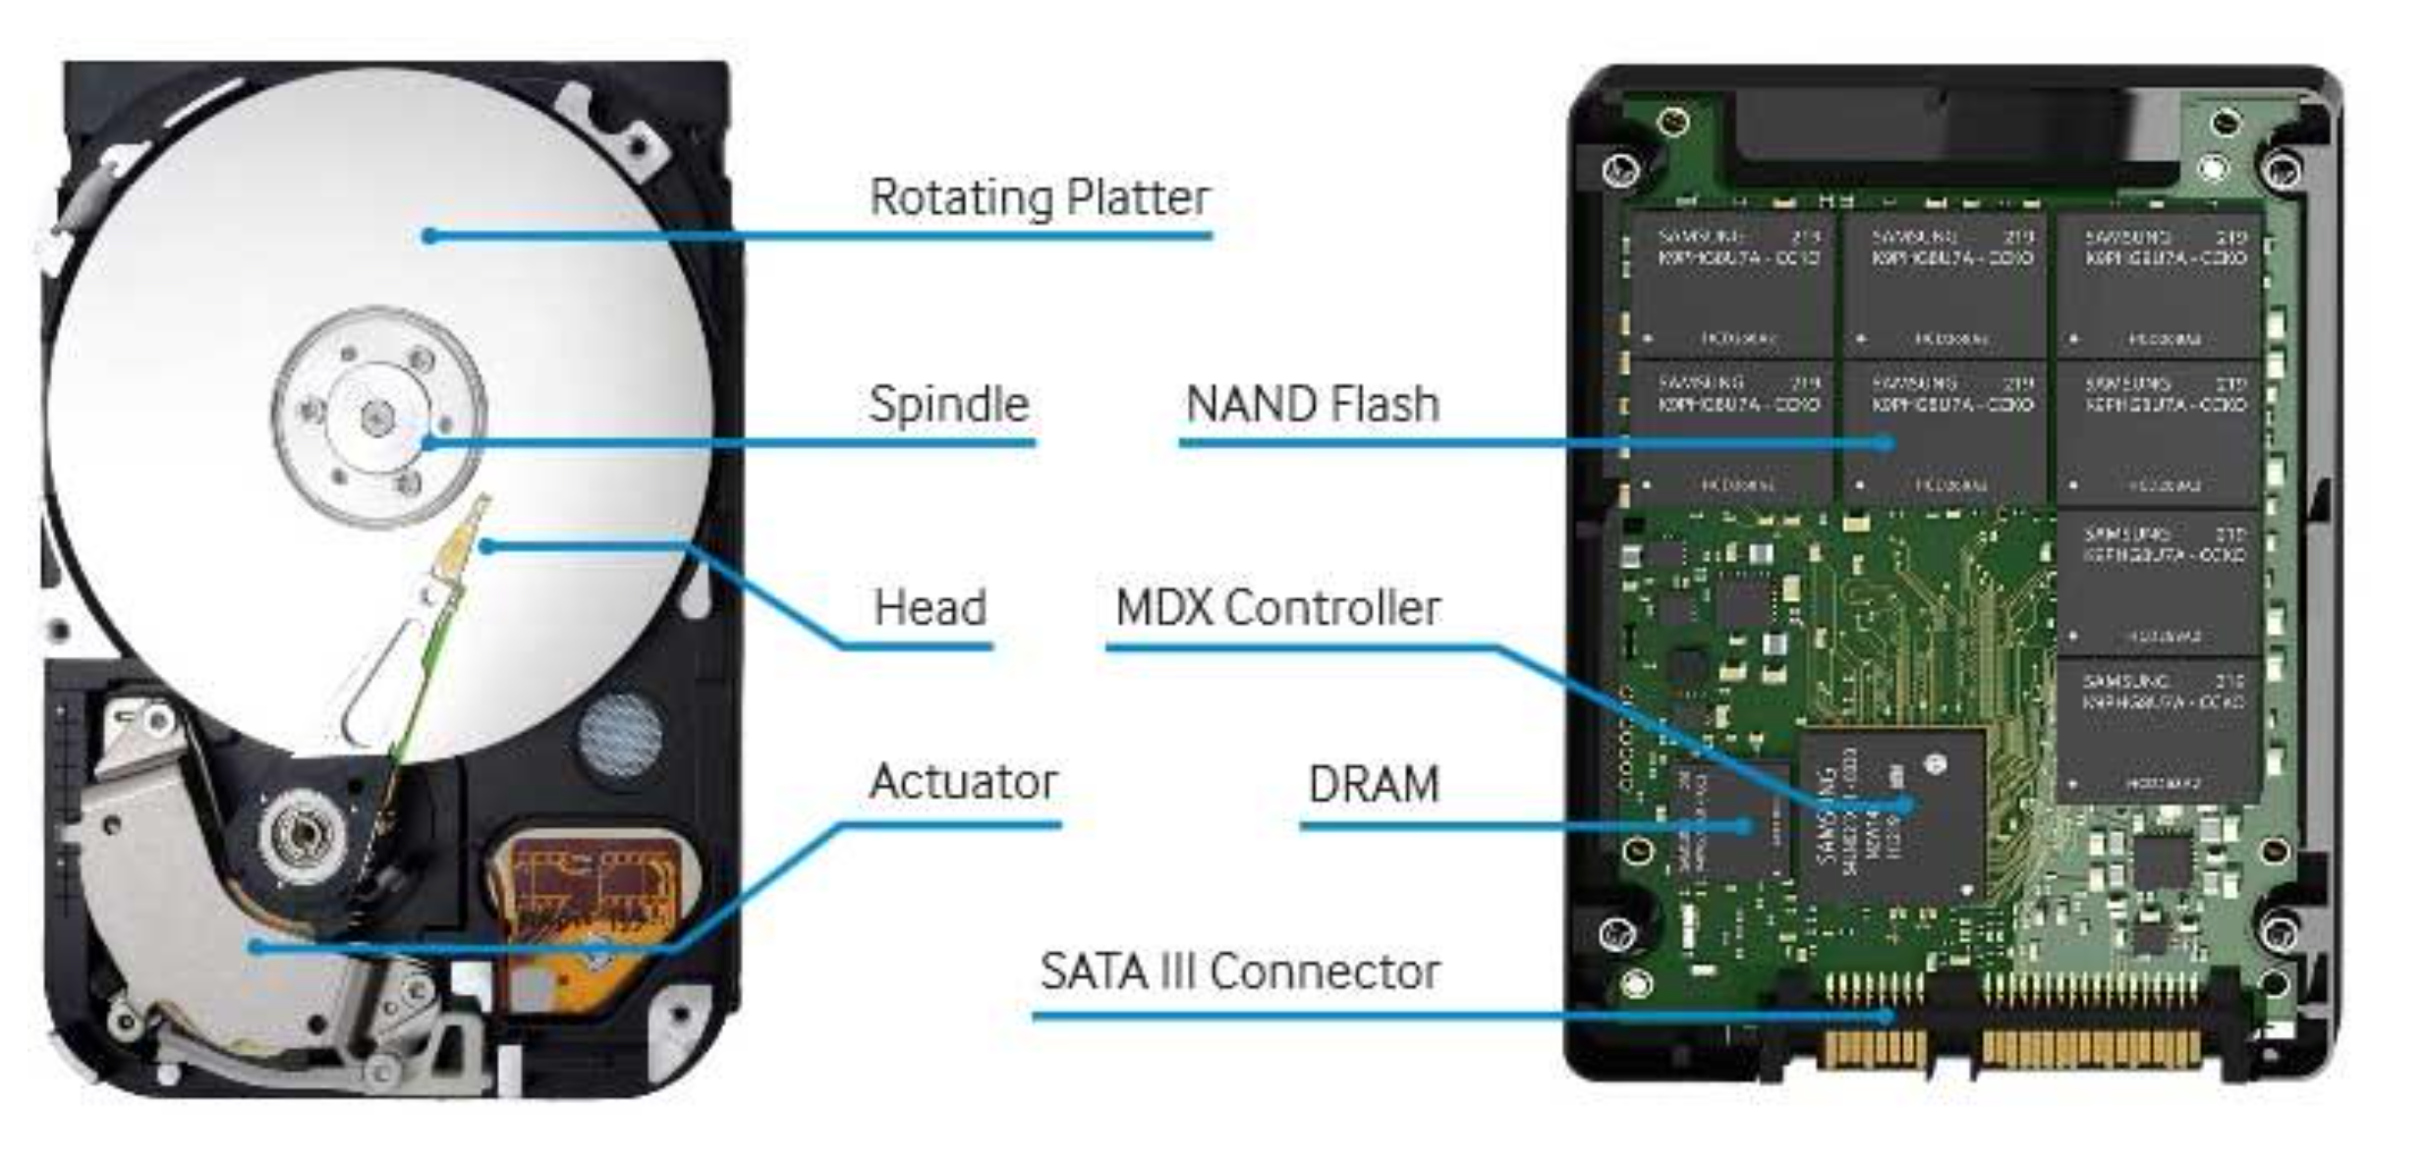
HardDrive vs. SSD

Slide 5
Disk and Files
DBMS store information on disks!
Disks are relatively slow
READ: Disk -> main memory
WRITE: Main memory -> disk
READ/WRITE operation are expensive!

Slide 6
Hard Disks
Storage device of choice.
random access vs. sequential access
Data is stored and retrieved in units called disk blocks or pages.
Time to retrieve a disk page depends upon location on disk.
Relative placement of pages on disk is affects READ/WRITE speed

Slide 7
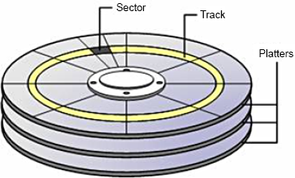
Anatomy of a Hard Disk
Sector
Track
Cylinder
Platter
Sector size: Fixed
Block size: Multiple of sector size

Slide 8
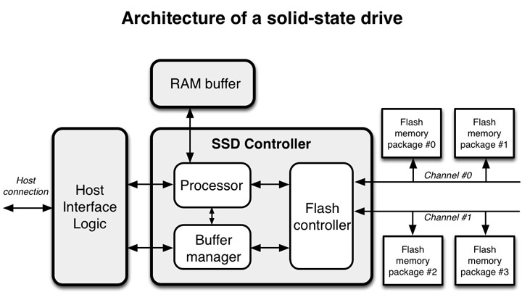
Anatomy of a SSD Drive
Sector
Track
Cylinder
Platter
Sector size: Fixed
Block size: Multiple of sector size

Slide 9
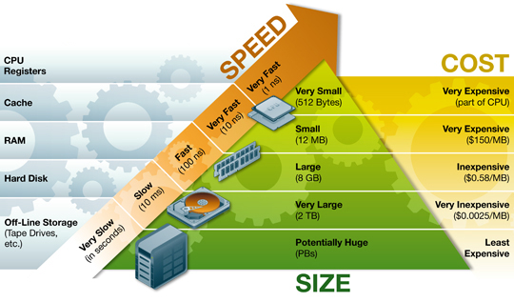
Storage Hierarchy

Slide 10
Disk Page = Disk Block
Time to access (read/write) a disk block:
Seek time:
Moving arms to position disk head on track
Rotational delay:
Waiting for block to rotate under head
Transfer time:
Actually moving data to/from disk surface

Slide 11
Speed Comparison
 | Hard Drive | SSD
Seek time | about 1 to 20ms | 0.05-0.5 ms
Rotational delay | 0 to 10ms | N/A
Transfer time | < 1msec per 4KB page | 200MB/s

Slide 12
Arranging Pages on a Disk
Next block concept:
blocks on same track, followed by
blocks on same cylinder, followed by
blocks on adjacent cylinder
Accessing ‘next’ block is cheap
An important optimization: pre-fetching
More information (See R&G page 323)

Slide 13
Database System Architecture
Data Manipulation Language
(DML)
Data Definition Language
(DDL)
Query processing
Query evaluator
DML procedures
Query optimizer
Meta data
Storage manager
Transaction Manager
Buffering Manager
File Manager
Physical Level

Slide 14
Buffer
DBMS
Buffer Manager
Physical Level

Slide 15
Storing Data/Dirty Page
DBMS
Buffer Manager
Physical Level

Slide 16
Page Fault
DBMS
Buffer Manager
Physical Level

Slide 17
Buffer manager
DBMS require all pages to be in RAM
Buffer manager encapsulate access disk
Implements a strategy to handle page faults

Slide 18
Strategy
Keep page counter
Counter = 0 and page not dirty: flag as replaceable
Counter = 0 and page dirty: write to disk
Which page to pick?
Least Recently Used (LRU) page
But there are others
[See R&G]

Slide 19
Database System Architecture
Data Manipulation Language
(DML)
Data Definition Language
(DDL)
Query processing
Query evaluator
DML procedures
Query optimizer
Meta data
Storage manager
Transaction Manager
Buffering Manager
File Manager
Physical Level

Slide 20
Files for DBMS
Data | Page | 1
Pages
Data pages
Header pages
Information
Empty space
Alternative Header page structures
Header | Page | 1
Data | Page | 2
Data | Page | 3
Header | Page | 2
Data | Page | n
Header | Page | 3

Slide 21
Page Formats
How to fit records into a (4kB page!)?
Fixed Length Records and Variable Length Records
How to retrieve a record?
How to insert a record?
How to delete a record?

Slide 22
Fixed Length Records

Slide 23
Retrieval
Retrieval
Define RecordID
rid = pid:slotID
Insertion
Deletion
Page 1
Slot 1
Slot 2
Slot 3
Slot 4
slotID=4

Slide 24
Insertion
Retrieval
Define RecordID
rid = pid:slotID
Insertion
Insert and increase
Deletion
Page 1
Slot 1
Slot 2
Slot 3
Slot 4
Slot 5
slotID=5

Slide 25
Deletion
Retrieval
Define RecordID
rid = pid:slotID
Insertion
Insert and increase
Deletion
Bit Indexes
Page 1
Slot 1
Slot 2
Slot 3
Slot 4
Slot 5
slotID=5

Slide 26
Variable Length Records

Slide 27
Retrieval
Retrieval
Slot Directory
Define RecordID
rid = pid:slotID
Insertion
Deletion

Slide 28
Insertion
Retrieval
Slot Directory
Define RecordID
rid = pid:slotID
Insertion
Add new record
Deletion

Slide 29
Deletion
Retrieval
Slot Directory
Define RecordID
rid = pid:slotID
Insertion
Add new record
Deletion

Slide 30
Deletion
Retrieval
Slot Directory
Define RecordID
rid = pid:slotID
Insertion
Add new record
Deletion
Update entire page

Slide 31
Database System Architecture
Data Manipulation Language
(DML)
Data Definition Language
(DDL)
Query processing
Query evaluator
DML procedures
Query optimizer
Meta data
Storage manager
Transaction Manager
Buffering Manager
File Manager
Physical Level

Slide 32
The Need For Speed
SELECT *
FROM R
WHERE <condition>
Full table scans
Range queries
Point queries
SELECT * FROM Person WHERE year(birthdate)
BETWEEN 1975 and 1994
SELECT * FROM Person WHERE birthyear=1975

Slide 33
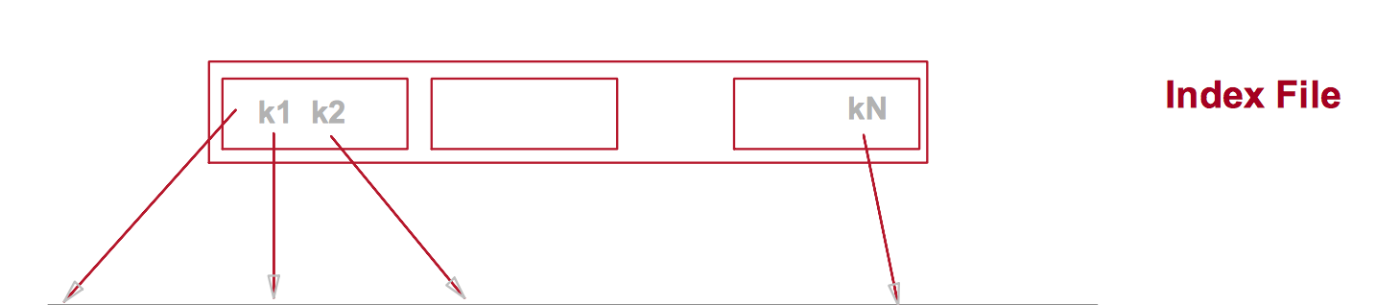

Indexes
SELECT * FROM Person WHERE year(birthdate)
BETWEEN 1975 and 1994

Slide 34
Contents
Indexed Sequential Access Method (ISAM)
B – trees
B+ – trees
MySQL index

Slide 35
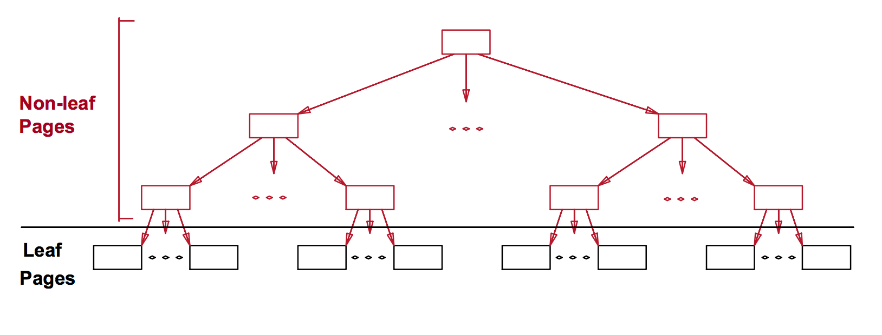
ISAM
Originally developed by IBM
Fixed Length Records
Sequential data + Index datastructure

Slide 36
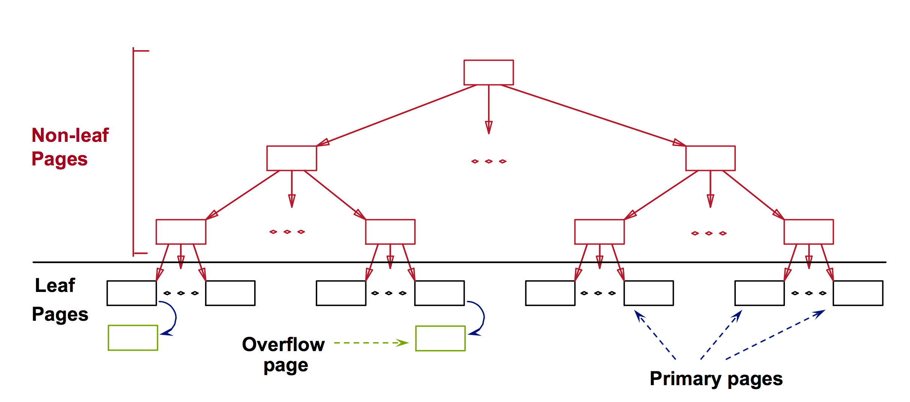
Insertion and Overflow

Slide 37
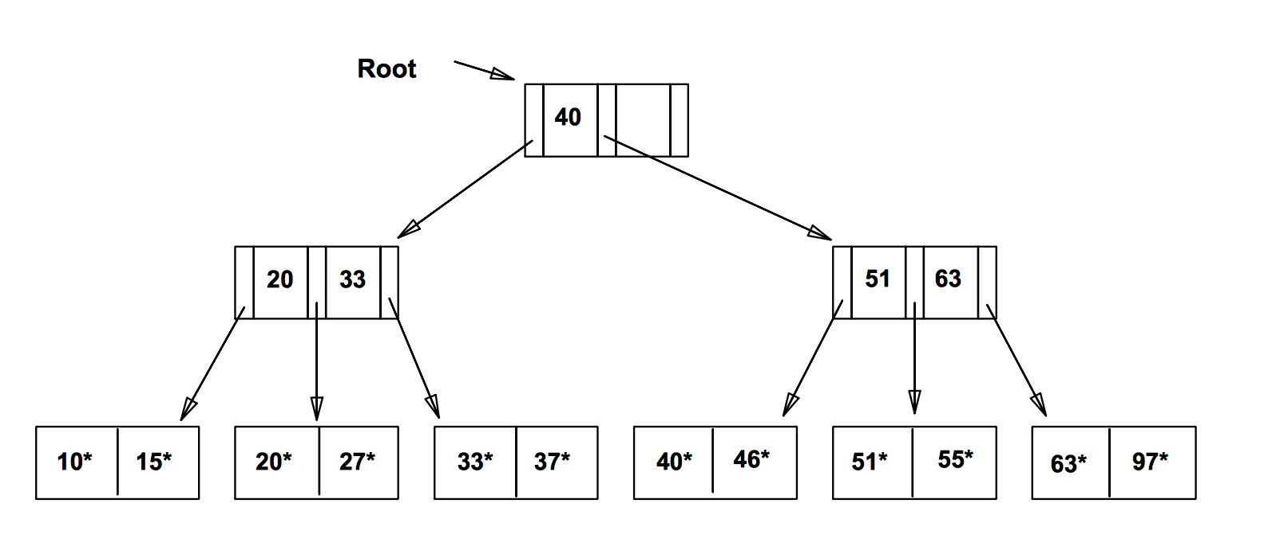
ISAM in Action
Key
Key + rest of the record

Slide 38
Properties
ISAM is a static structure
Retrieval:
Cost: O (log_{F} N)
Fan-Out: F = 2
Size: N = 12

Slide 39
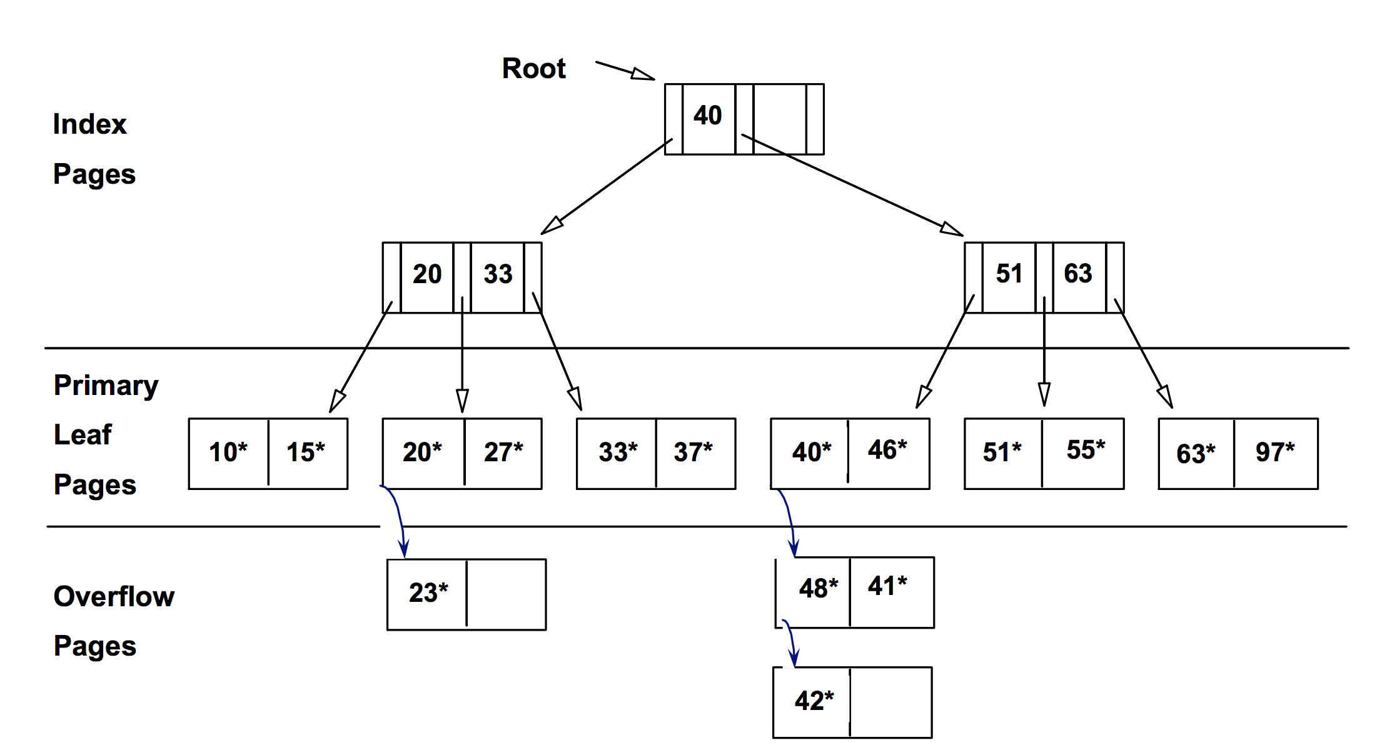
Insertion 23*, 48*, 41*, 42*

Slide 40
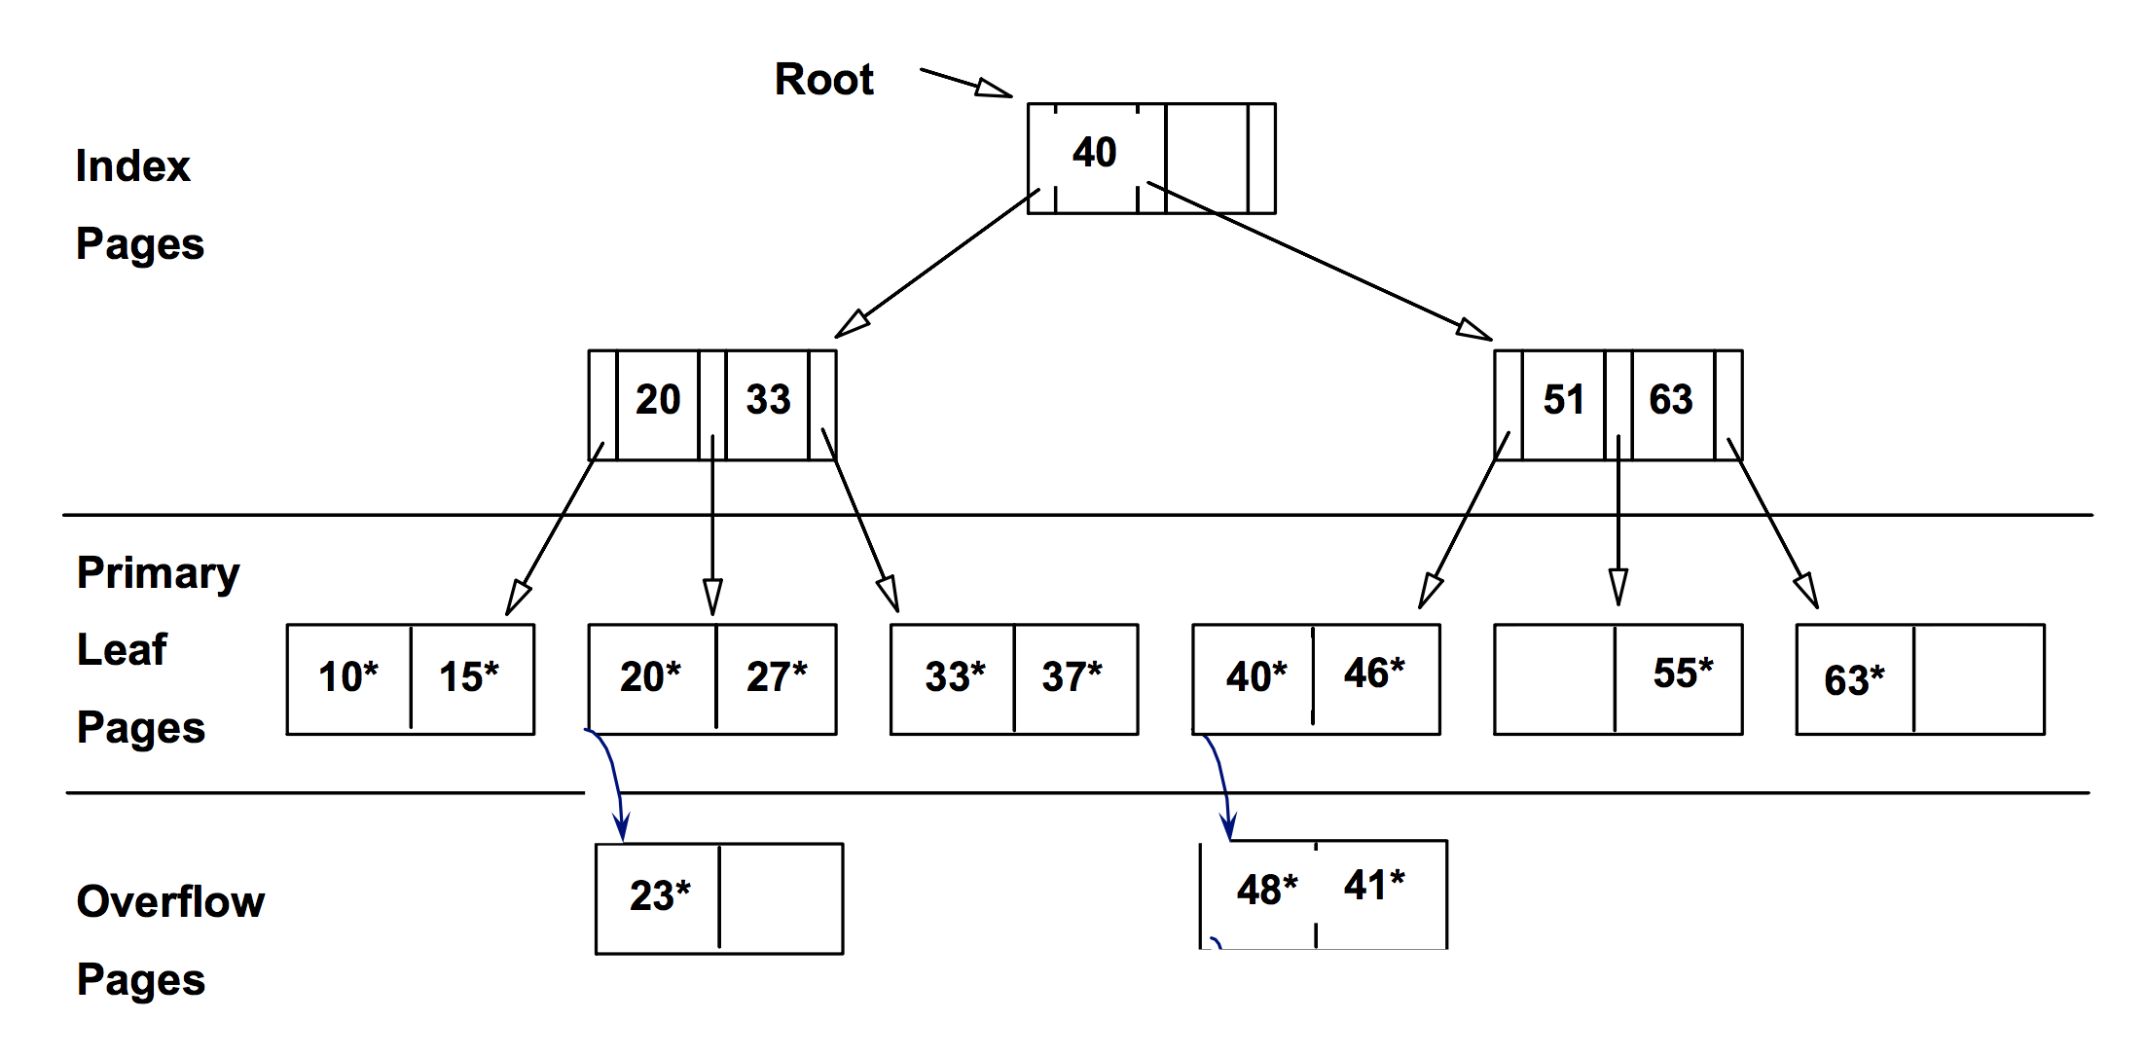
Deletion 42*, 51*, 97*
Note 51 still here

Slide 41
Contents
Indexed Sequential Access Method (ISAM)
B – trees
B+ – trees
MySQL index

Slide 42
B-Trees
[Rudolf Bayer and McCreight, E. M. Organization and Maintenance of Large Ordered Indexes. Acta Informatica 1, 173-189, 1972.]
http://slady.net/java/bt/

Slide 43
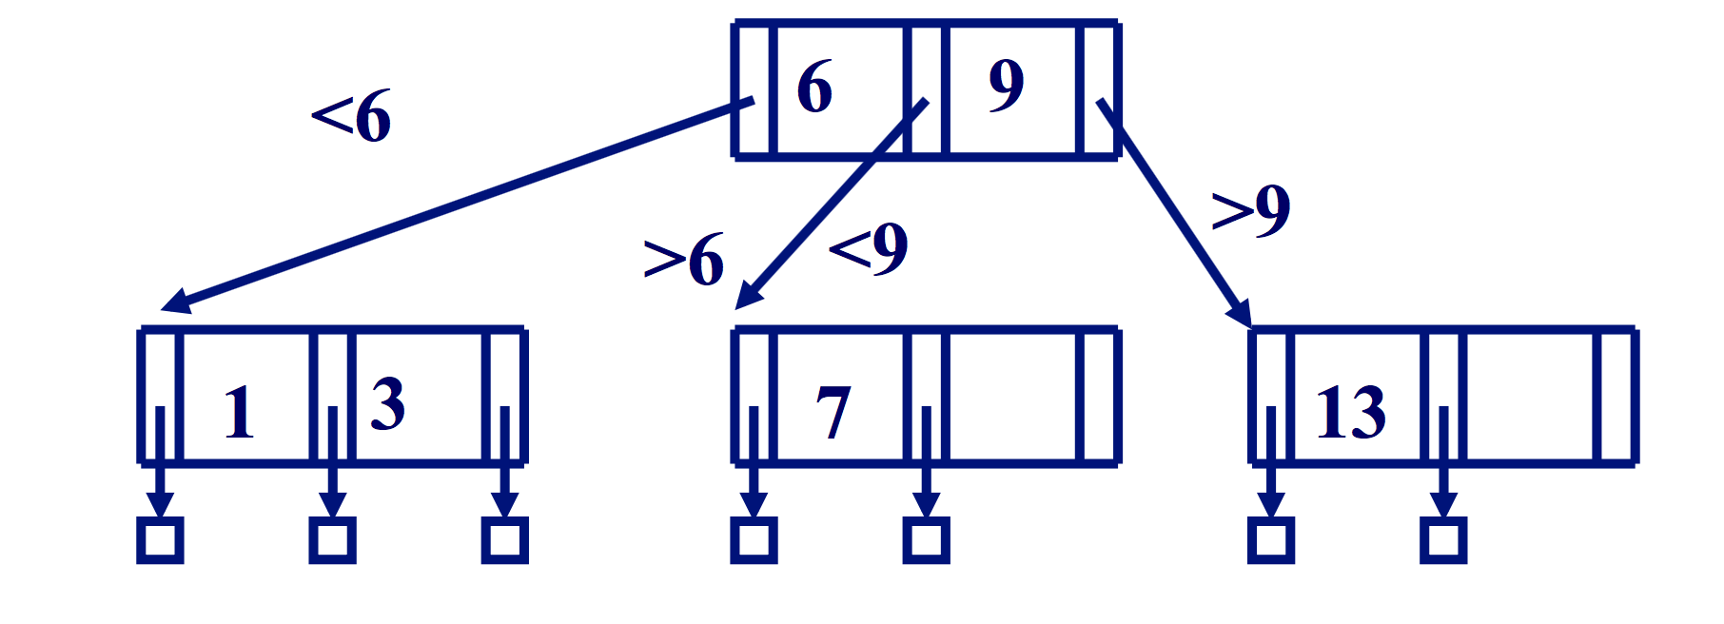
Point Queries
SELECT * FROM Person WHERE birthyear=8

Slide 44
Range Queries
SELECT * FROM Person WHERE 5 < age < 8

Slide 45
Insertion
Insert 8 into the tree below!
8

Slide 46
Insertion
Push the 2 up into the tree
2

Slide 47
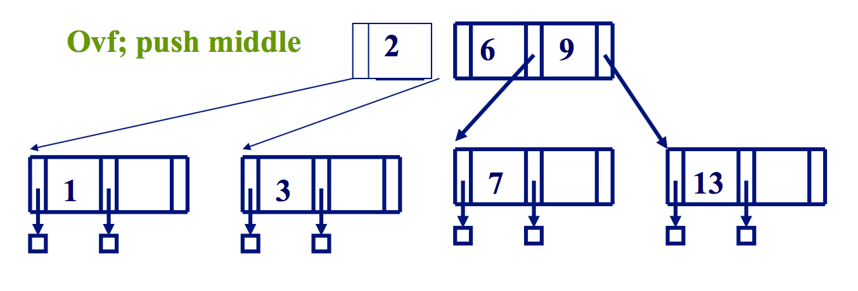
Insertion
Push the 2 up into the tree

Slide 48
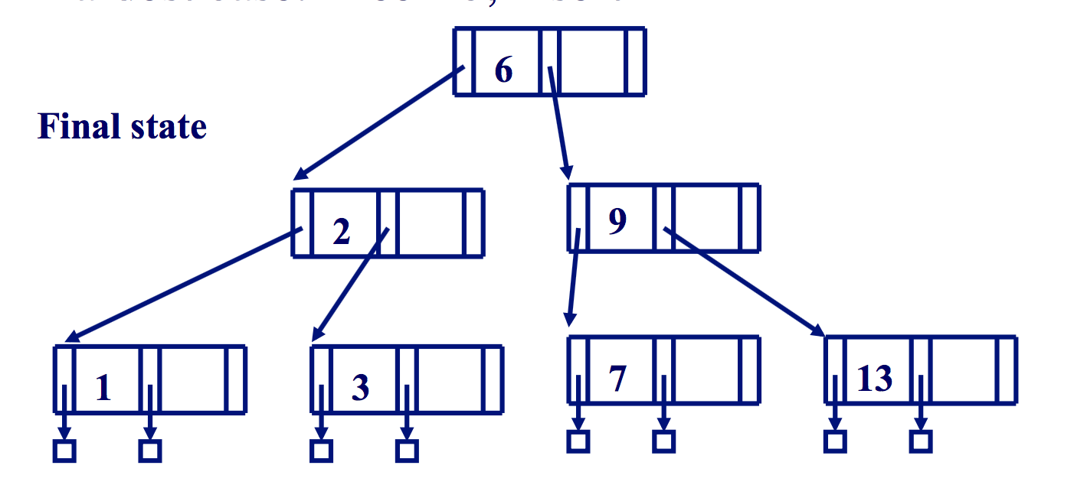
Insertion

Slide 49
Insertion Algorithm B – Tree
fun insert(k:key) =
(find the correct leaf node l;
if (l overflows) then
(split l and push middle to
parent node p;
if p overflows then
push recursively)
else insert k into l)

Slide 50
B-Trees
Always balanced
The nodes are always at least 50% full
Height increases in case of overflow
Deletion inverse of insertion but much much more complicated. See [R&G]

Slide 51
Contents
Indexed Sequential Access Method (ISAM)
B – trees
B+ – trees
MySQL index

Slide 52
Clustered and Non-Clustered Index
Clustered index: Leaf nodes are in order
Non-clustered index: Leaf nodes are not in order

Slide 53
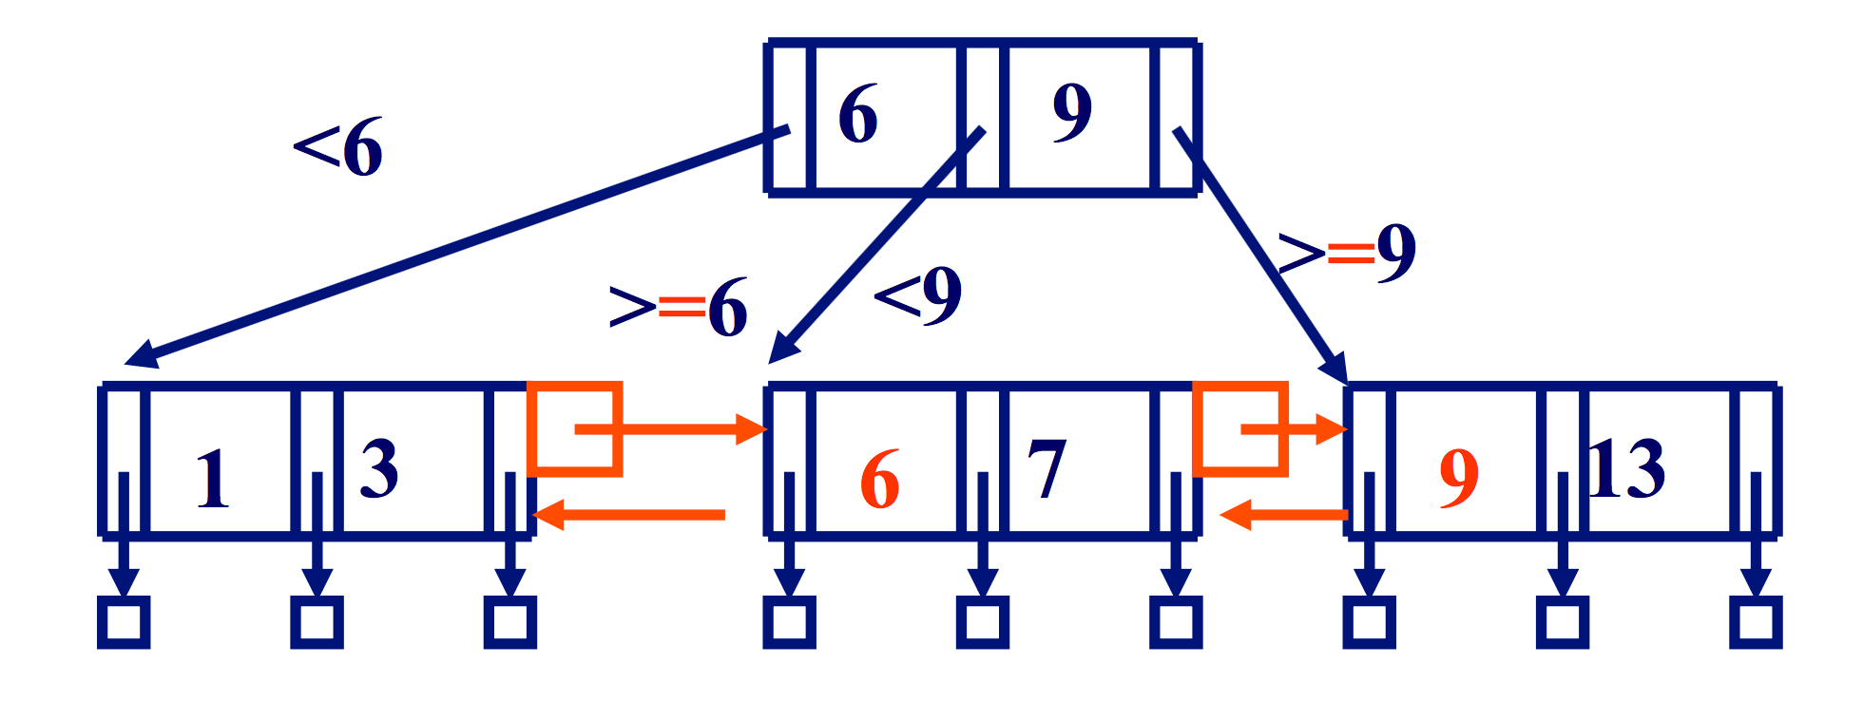
B+ – trees
Link leaf nodes
Each key appears in the leaf nodes

Slide 54
Insertion Algorithm B+ – Tree
fun insert(k:key) =
(find the correct leaf node l;
if (l overflows) then
(split l and push middle key to parent node p;
if p overflows then
push recursively)
else insert k into l)
copy

Slide 55
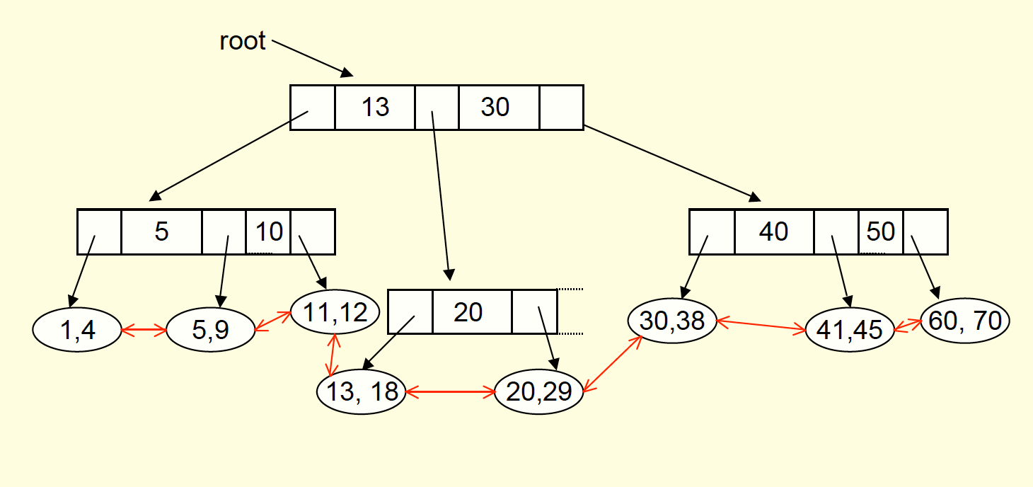
Example B+ - Tree
Insert 19
[thanks to Princeton]

Slide 56
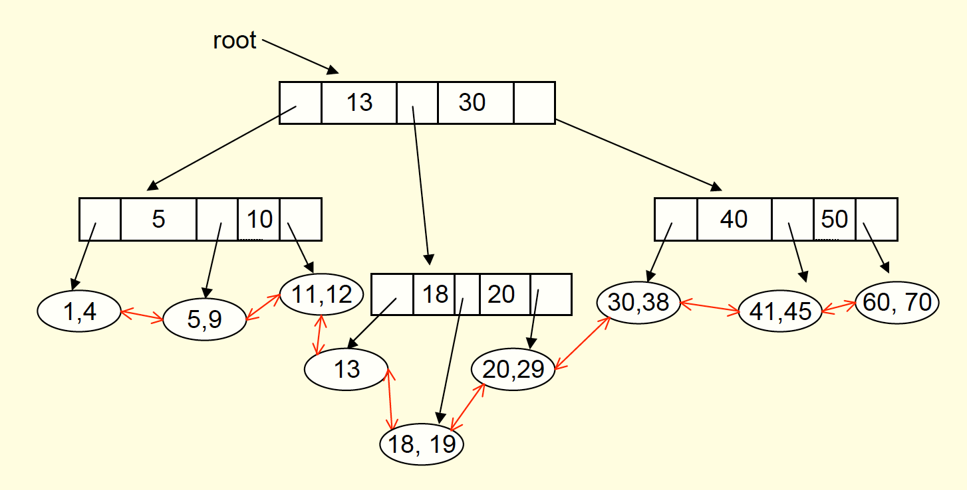
Example B+ - Tree
Insert 27

Slide 57
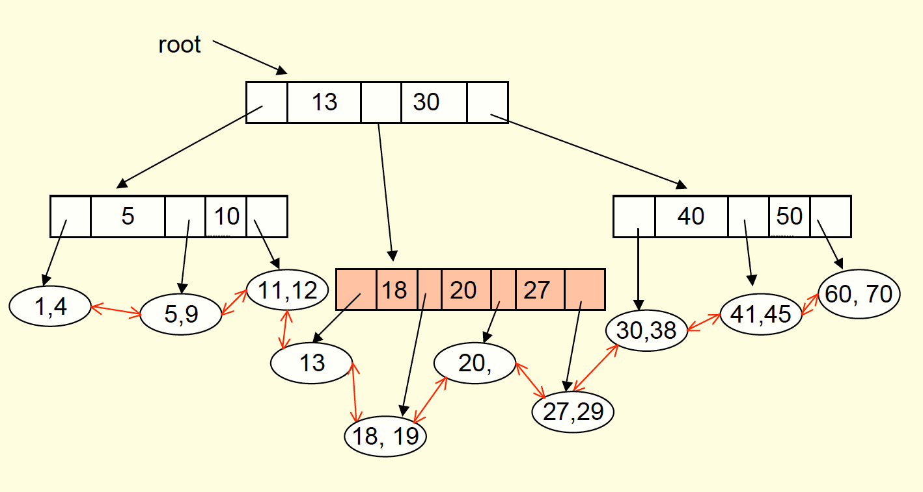
Example B+ - Tree

Slide 58
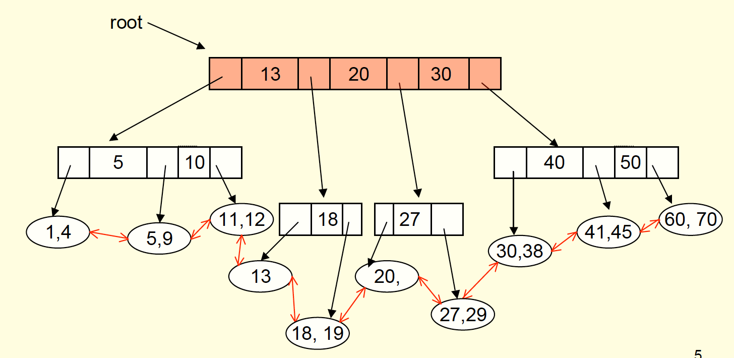
Example B+ - Tree

Slide 59
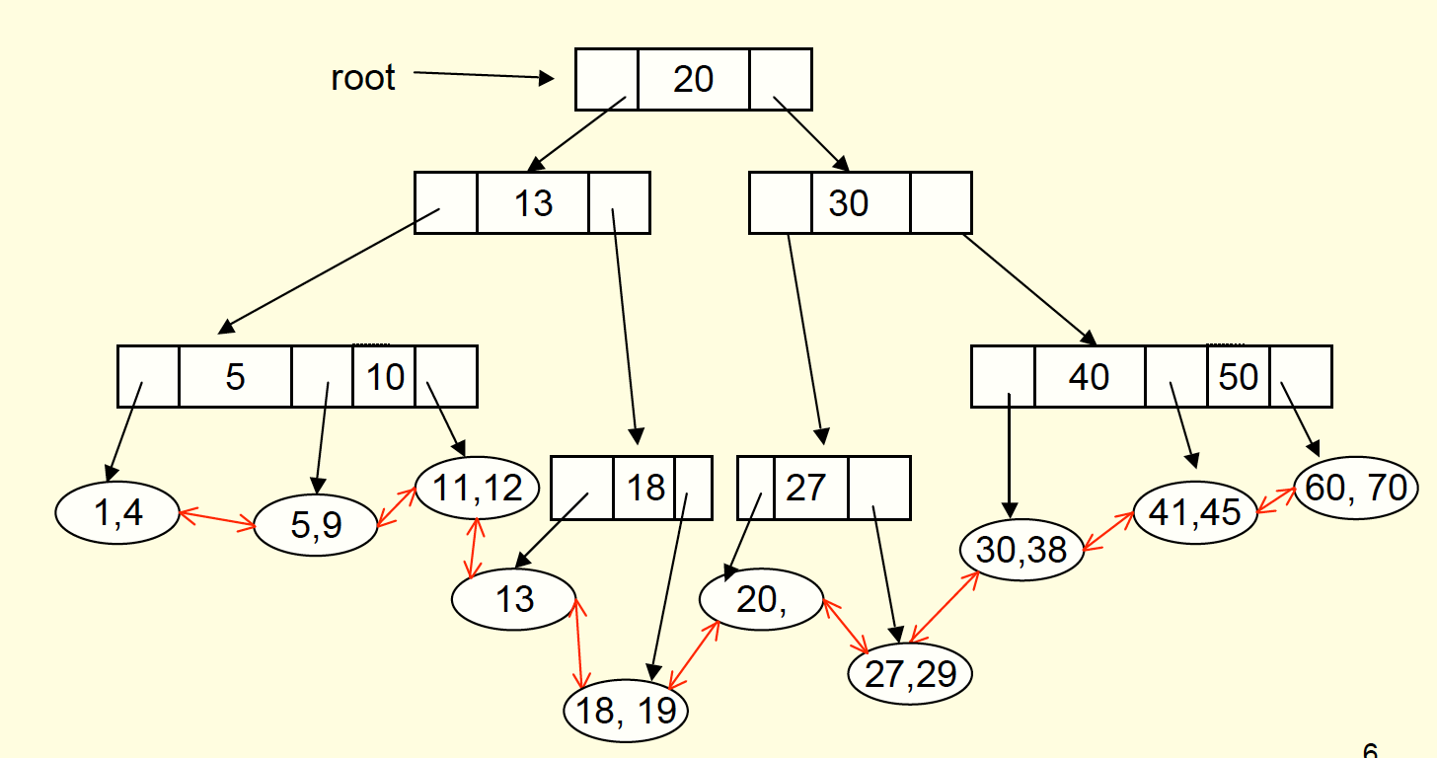
Example B+ - Tree

Slide 60
Summary
B+ trees
Great data structure for indexes
Order d of B+tree: minimal number of keys in a non-leaf node
Maximal number of 2d keys in a non-leaf node
Maximal fan-out of 2d+1 of children nodes
Supports clustered index, full table scans, range queries, and point queries.

Slide 61
Contents
Indexed Sequential Access Method (ISAM)
B – trees
B+ – trees
MySQL index

Slide 62
Clustered Index / Primary Index
CREATE TABLE Person
(
pid int NOT NULL,
lastName varchar(255) NOT NULL,
firstName varchar(255),
birthdate DATE,
city varchar(255),
PRIMARY KEY (pid)
)

Slide 63
Secondary Index
Creates two non-clustered indexes on table Person.
CREATE INDEX myIndex1
ON Person(lastname);
CREATE INDEX myIndex2
ON Person(firstname, city);

Slide 64
Efficiency Gain
Index
Range query
DBMS computes best execution plan!
CREATE INDEX myIndex2
ON Person(firstname, city);
SELECT * FROM person WHERE firstname=’John’
and birthdate < ’1950-1-1’

Slide 65
More about this next time!

